Slide 1

Android Based Biometric Attendance Management System
Nice Infotech

Slide 2
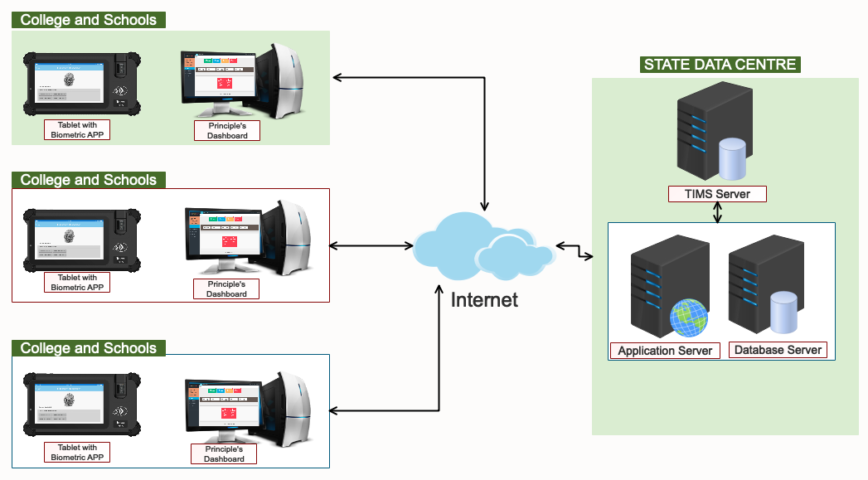
Network connectivity Layout
Nice Infotech

Slide 3
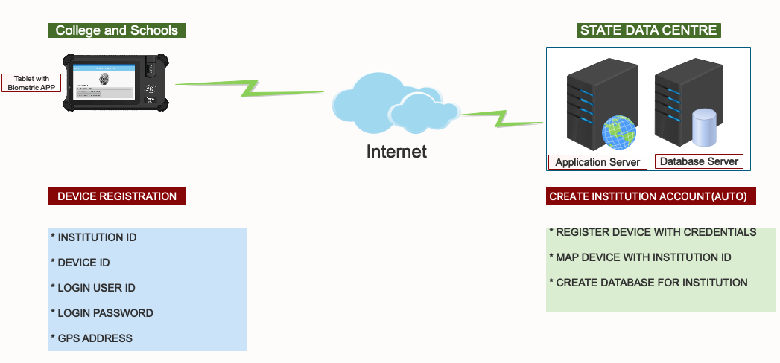
DEVICE REGISTRATION
Nice Infotech

Slide 4
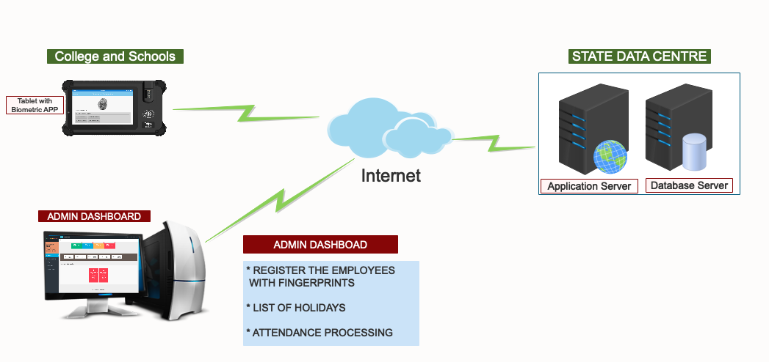
EMPLOYEES’ REGISTRATION WITH FINGERPRINT
Nice Infotech

Slide 5
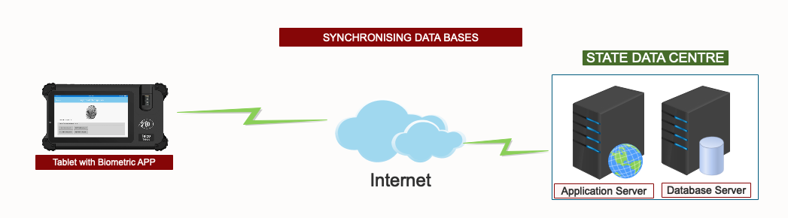
Nice Infotech

Slide 6
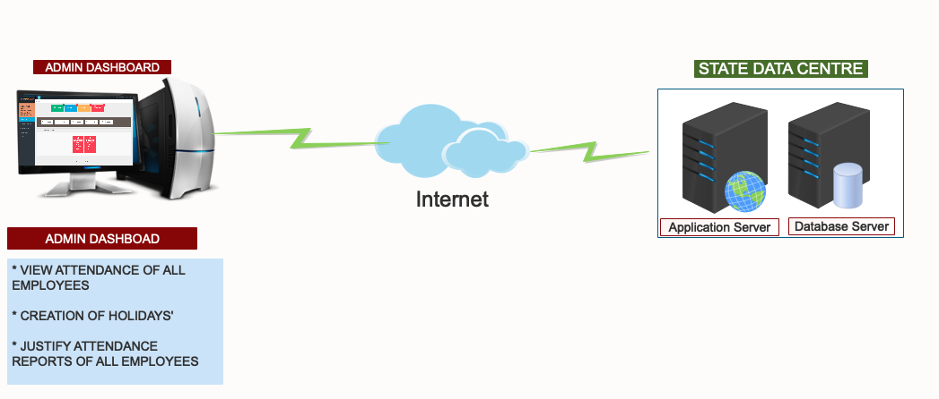
PROCESSING ATTENDANCE
Nice Infotech

Slide 7
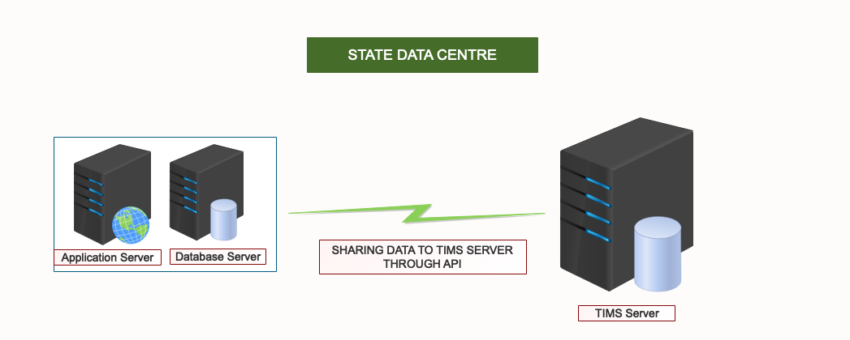
Nice Infotech

Slide 8

Nice Infotech

